Slide 1

Programming Principles
1811ICT/2807ICT/7001ICT
Week 4 Lecture
Dr Mardé Helbig

Slide 2



Assessments – Quiz 1
Quiz 1
Quiz 1 in Week 5 (15% towards final grade) 3 time slots on 21 August: 6-9am (AEST), 12-2pm (AEST) and 7-9pm (AEST) Only have 1 try and once you start you have 45 minutes to complete it Online – will make an announcement Monday 19 August on course site and Microsoft Teams’ General channel with the link Only available in those 3 time slots Students that applied for extension will be contacted after 21 August with information about the alternative arrangements
IMPORTANT: Apply for extension if you cannot do Quiz 1 during these time slots, but EVIDENCE must be provided

Slide 3

Recap
>>> python elseScript.py
You win if you guess the magic number.
Guess the number: 3
Wrong number.
Thank you for playing! Better luck next time!
>>>
>>> python elseScript.py
You win if you guess the magic number.
Guess the number: 7
Congratulations! You win!
Lucky number 7!
>>>
>>> python elseScript.py
You win if you guess the magic number.
Guess the number: 98
Wrong number.
Thank you for playing! Better luck next time!
#elseScript.py
#Ask for a number from the user
#If the number is 7, the user wins
print("You win if you guess the magic number.")
num = int(input("Guess the number: "))
if (num == 7):
print("Congratulations! You win!")
print("Lucky number 7!")
else:
print("Wrong number.")
print("Thank you for playing! Better luck next time!")

Slide 4
control flow statements
Control flows through program statements from top to bottom
Except where control flow statements alter this sequence with selections and loops
Selections: structures where program decides whether to execute some statements or not (if, elif, else)
Loops: structures where programs repeat statements multiple times

Slide 5
Loops
Indefinite loops: do not know how many repetitions are required – will repeat until a specified condition is met (while loop)
Definite loops: know how many repetitions are required (for loop)

Slide 6
Control and Data
Section 12: indefinite loops with while

Slide 7
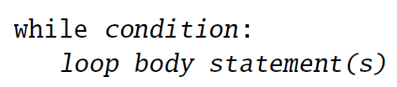
while loop
Condition is evaluated before loop executes => can be repeated zero or more time
Expression evaluated to be True or False
Keyword indicating while loop
: separates body statement(s) from condition
Demo script files
Statements executed repeatedly while the condition is True
Statements are indented!

Slide 8

While loop
Want to print the numbers 1 to 10 on one line
# whileLoop1.py
# print the numbers 1 to 10 on one line
i = 1 #initialisation is first time we give value
while (i <= 10):
print(i, end=“ “) #space after value, not new line
print() #adding a newline after all values are printed
Will this code work?
# whileLoop1.py
# print the numbers 1 to 10 on one line
i = 1 #initialisation is first time we give value
while (i <= 10):
print(i, end=“ “) #space after value, not new line
#must update value of i
i = i + 1 #adding 1 to i’s value, incremented i
print() #adding a newline after all values are printed
What is missing?
Value of i should change make condition false

Slide 9
While loop
Want to print the numbers from 10 down to 1 on one line
How can we adapt the previous code to do this?
# whileLoop2.py
# print the numbers 10 to 1 on one line
i = 10 #initialisation is first time we give value
while (i >= 1): #or while (i > 0)
print(i, end=“ “) #space after value, not new line
#must update value of i
i = i - 1 #subtracting 1 from i’s value, decremented i
print() #adding a newline after all values are printed

Slide 10
While loop
How can we improve the magic number example using a while loop?
How should we go about changing the code?
# whileLoop3.py
# changing magic number example using while loop
#user should keep guessing until they get the number correct
correctNumber = 7
#when should we stop the while loop?
while (): #what should be the condition here?
#what do we get from the user?
num = input(“Enter a number: “)
# whileLoop3.py
# changing magic number example using while loop
#user should keep guessing until they get the number correct
correctNumber = 7
#when should we stop the while loop?
while (num !=7): #what should be the condition here?
#what do we get from the user?
num = input(“Enter a number: “)
Will the above code work?

Slide 11
While loop
How can we improve the magic number example using a while loop?
How should we go about changing the code?
# whileLoop3.py
# changing magic number example using while loop
#user should keep guessing until they get the number correct
correctNumber = 7
#getting first number from user
num = float(input(“Enter a number: “))
#when should we stop the while loop?
while (num !=7):
#print message to user, hint for next guess
if (num < 7):
print(“Incorrect guess. Number is too small!”)
else: #why only 1 alternative here and not 2?
print(“Incorrect guess. Number is too large!”)
#get next number from user
num = float(input(“Try again! Enter a number: “))
What is the problem here?
What do we print if guess is correct?
Can an alternative condition be added?
How can we solve this?

Slide 12

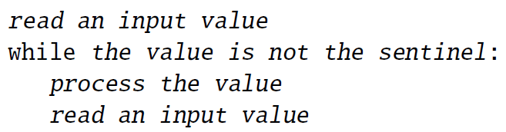
Loops – Sentinel pattern
The magic number code is an example of a sentinel pattern
Program reads input until a specified value (called the sentinel) is read, which indicates that end of program has been reached:

Slide 13

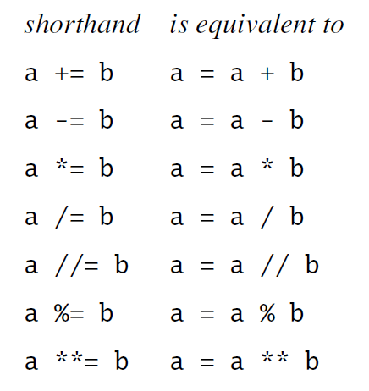
Shorthand Assignment operators
When did we use the assignment operator (=) so far?
Python provides a shorthand for assignment operators:
Demo in REPL
Where will this be useful?

Slide 14


While loop – problem solving
You want to determine the average of a student’s grades for their courses completed so far. Prompt the student for their grade until a negative grade is entered. Print out the number of grades entered and the student’s average grade.
Why is a negative grade a good sentinel to use?
# Problem solving
# Want to determine average of a student’s grades
# What do we need to know to calculate the average?
#avgGrade = ....
#Will need:
# - sum of grades entered (only valid grades!)
# - number of valid grades entered

Slide 15
While loop – problem solving
You want to determine the average of a student’s grades for their courses completed so far. Prompt the student for their grade until a negative grade is entered. Print out the number of grades entered and the student’s average grade.
# Problem solving
# Want to determine average of a student’s grades
# What do we need to know to calculate the average?
#avgGrade = ....
# averageGrade.py
# calculates the average grade
#sentinel pattern
#read first value
#check value against condition
#repeat the following statements
#read next value
#print out results (number of marks entered and average)
#Will need:
# - sum of grades entered (only valid grades!)
# - number of valid grades entered

Slide 16

While loop – problem solving
You want to determine the average of a student’s grades for their courses completed so far. Prompt the student for their grade until a negative grade is entered. Print out the number of grades entered and the student’s average grade.
# Problem solving
# Want to determine average of a student’s marks
# What do we need to know to calculate the average?
#avgGrade = ....
# averageGrade.py
# calculates the average grade
#sentinel pattern
#read first value
grade = input(“Enter a mark (negative value to stop): “)
#check value against condition – not sentinel value
while (grade >= 0):
#repeat the following statements
#what do we do with value?
#why here? why not after reading?
#read next value
grade = input(“Enter a mark (negative value to stop): “)
#print out results (number of marks entered and average)
#Will need:
# - sum of grades entered (only valid grades!)
# - number of valid grades entered
How would you extend this code to also print out the highest and lowest grade?

Slide 17
While loop – problem solving
You want to determine the average of a student’s grades for their courses completed so far. Prompt the student for their grade until a negative grade is entered. Print out the number of grades entered and the student’s average grade
# averageGrade.py - calculates the average grade
#sentinel pattern
#read first value
grade = input(“Enter a grade (negative value to stop): “)
#check value against condition – not sentinel value
while (grade >= 0):
#repeat the following statements
#what do we do with value?
#why here? why not after reading?
sum += grade
num += 1
#read next value
grade = input(“Enter a grade (negative value to stop): “)
#print out results (number of grades entered and average)
print(“Number of grades: “, num)
print(“Average grade: “, sum/num)
#Will need:
# - sum of grades entered (only valid grades!)
# - number of valid grades entered
Will this code work?

Slide 18

While loop – problem solving
You want to determine the average of a student’s marks for their courses completed so far. Prompt the student for their mark until a negative mark is entered. Print out the number of marks entered and the student’s average mark.
# averageGrade.py - calculates the average grade
#sentinel pattern
#read first value
grade = float(input(“Enter a grade (negative value to stop): “))
#check value against condition – not sentinel value
sum = 0
num = 0
while (grade >= 0):
#repeat the following statements
#what do we do with value?
#why here? why not after reading?
sum += grade
num += 1
#read next value
grade = float(input(“Enter a grade (negative value to stop): “))
#print out results (number of grades entered and average)
print(“Number of grades: “, num)
print(“Average grade: “, sum/num)
#Will need:
# - sum of grades entered (only valid grades!)
# - number of valid grades entered
What are some important observations?

Slide 19

Any questions?
Type your question in the Q&A or raise your hand

Slide 20












Temperature Check
How do you feel about while loops?

Slide 21
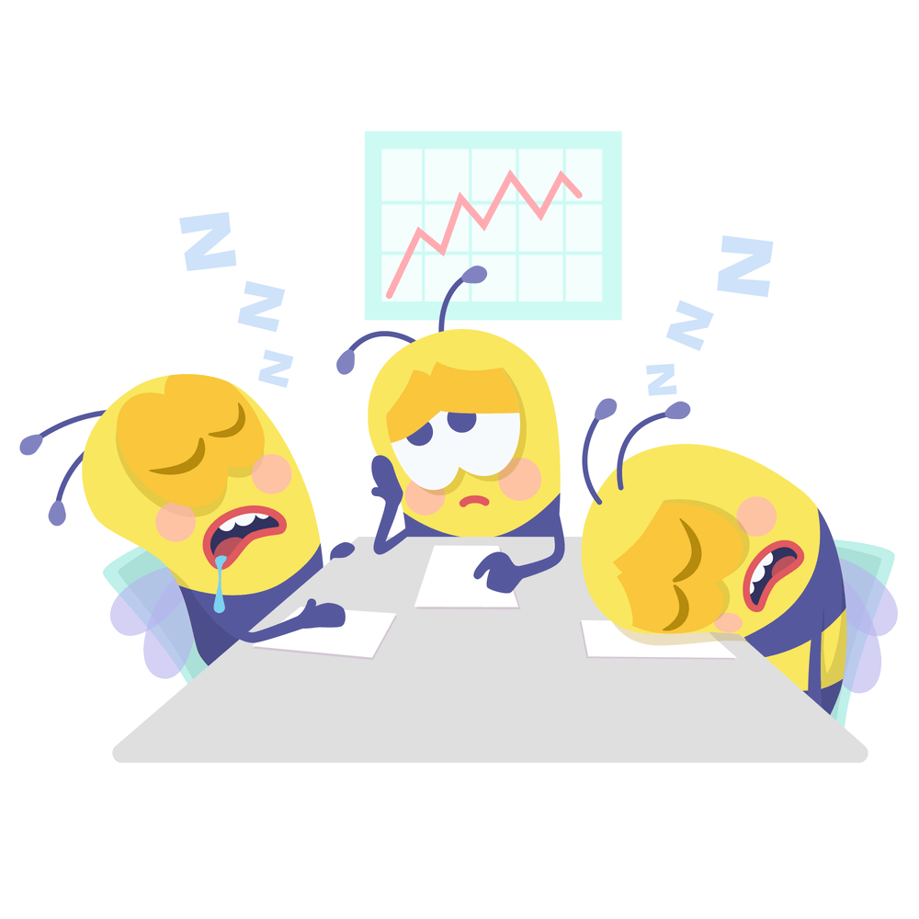
5 Minute Break Time!

Slide 22
Control and Data
Section 13: definite loops with for

Slide 23
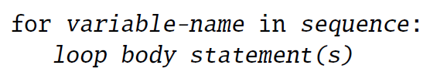
For loop
variable name that will be used to iterated over sequence
Keyword indicating for loop
sequence of values that variable-name will be assigned each time the loop body executes
: separates body statement(s) from sequence
Demo script files
Statements executed repeatedly
Statements are indented!

Slide 24
For loop with strings
Processing a string character by character
>>> python forString.py
h
e
l
l
o
t
h
e
r
e
!
>>>
# forString.py
# print the characters of string vertically
myString = “hello there!”
for ch in myString:
print(ch) #default end=‘\n’

Slide 25
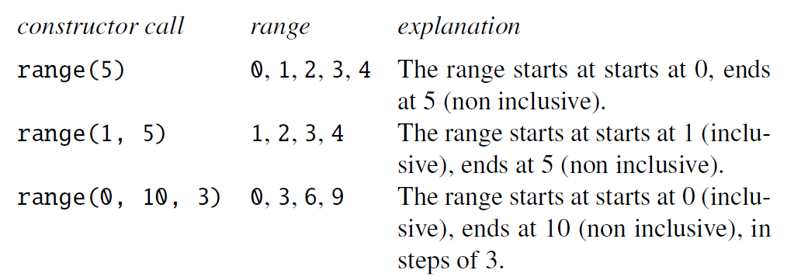
For loop with ranges
An instance of class range is an object that are a sequency of values
# forLoop1.py
# print the numbers 0 to 10 on one line
for i in range(11): #11 is not included
print(i, end=“ “) #we want all numbers on one line
print() #add new line after all numbers are printed
# forLoop2.py
# print the numbers 1 to 10 on one line
for i in range(1, 11): #11 is not included
print(i, end=“ “) #we want all numbers on one line
print() #add new line after all numbers are printed

Slide 26
For loop with ranges
An instance of class range is an object that are a sequency of values
# forLoop3.py
# print the numbers 5 to 25 in steps (increments) of 5 on one line
for i in range(5, 30, 5): #30 is not included
print(i, end=“ “) #we want all numbers on one line
print() #add new line after all numbers are printed
# forLoop4.py
# print the numbers 25 to 5 in steps (decrements) of 5 on one line
#descending order (from high to low) using -5 and not 5
for i in range(25, 0, -5): #0 is not included
print(i, end=“ “) #we want all numbers on one line
print() #add new line after all numbers are printed

Slide 27
for loop – problem solving
Prompt the user for the number of rows and columns, and then print out # accordingly, e.g.
Number of rows: 2
Number of columns: 7
#######
#######
# forLoop5.py
#prompt user for number of rows and columns
rows = int(input(“Number of rows: “))
columns = int(input(“Number of columns: “))
#what will we use here as sequence?
for r in range(1, rows): #why start with 1?
for c in range(1, columns):
#print (r, “ “, c) #printing out the values of r and c
print(“#”)
print() #print a new line after each row
What is happening here with a nested for loop?
Why is it not printing correctly?

Slide 28
For loop – problem solving
Prompt the user for a string. Print out the number of digits in the string.
# forLoop6.py
#prompt user for string
userString = input(“Enter a string: “)
#what will we use here as sequence?
num = 0
for s in userString:
#what will we check for?
if (type(s) == ‘int’):
num += 1
print(“Number of digits in string, “, userString, “ : “, num)
Why is it not working correctly?
Use built-in function: isnumeric()
... isalpha()

Slide 29
for loop – problem solving
You want to determine the average of a student’s grades for their courses completed so far. Prompt the student for their grade until a negative grade is entered. Print out the number of grades entered and the student’s average grade.
How will we change this problem to solve it with a for loop instead of a while loop?
You want to determine the average of a student’s grades for their courses completed so far. Prompt the student for the number of grades they want to enter and then prompt them for those grades. Print out the number of grades entered and the student’s average grade.
What are key differences here? Why?

Slide 30
for loop – problem solving
You want to determine the average of a student’s grades for their courses completed so far. Prompt the student for the number of grades they want to enter and then prompt them for those grades. Print out the number of grades entered and the student’s average grade.
# forLoop7.py
# changing grade example using for loop
#determine how many grades will be entered
gradeNumber = int(input(“How many grades will be entered: “))
total = 0 #sum of the grades
#using the for loop
for range(gradeNumber): #is this correct?
grade = float(input(“Enter a grade: “))
total += grade
print(“Number of grades: “, gradeNumber)
print(“Grade average: “, (total/gradeNumber))
Why is it not working correctly?

Slide 31
Any questions?
Type your question in the Q&A or raise your hand

Slide 32
Temperature Check
How do you feel about for loops?

Slide 33
Control and Data
Section 14: PASS, break, continue

Slide 34

control statements – pass, break, continue
These 3 control statements are used in the bodies of other control statements (such as if, for and while) to change their normal behaviour
But why? And how?

Slide 35
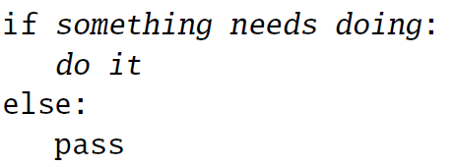
null operation – pass statement
The pass statement does nothing
Used as a placeholder where a statement is required but nothing should be done
For example:
# passStatement.py
# illustrate usage of pass statement
numbers = [0, 1, 2, 3]
for n in numbers:
if (not n):
pass #do nothing if n is 0
else:
n += 2
print(n) #print the result
>>> python passStatement.py
0
3
4
5

Slide 36
Break statement
The break statement terminates the execution of the loop body it occurs in, AND the loop itself
Most useful in for loops that achieve their aim before reaching the end of the sequence
Should be placed inside a selection inside the loop
# breakStatement.py
# illustrate usage of break statement
numbers = [0, 1, 2, 3]
for n in numbers:
if (n == 1): #if (not n): nothing. Why?
break #exits body of loop and loop
else:
n += 2
print(n) #print the result
>>> python breakStatement.py
2

Slide 37
Continue statement
The continue statement terminates the current execution of the loop body it occurs in, but NOT the loop
It skips to the next iteration of the loop
Should be placed inside a selection inside the loop
# continueStatement.py
# illustrate usage of continue statement
numbers = [0, 1, 2, 3]
for n in numbers:
if (not n):
continue #exits body of loop, skips to next iteration
else:
n += 2
print(n) #print the result
>>> python continueStatement.py
3
4
5

Slide 38
Any questions?
Type your question in the Q&A or raise your hand

Slide 39
Temperature Check
How do you feel about pass, break, continue?

